Slide 1
Video Object Segmentation for CVPR 2018 WAD Video Segmentation Challenge Dataset using OSVOS
Simmi Mourya, Mohamed Suhail
University of Pennsylvania

Slide 2
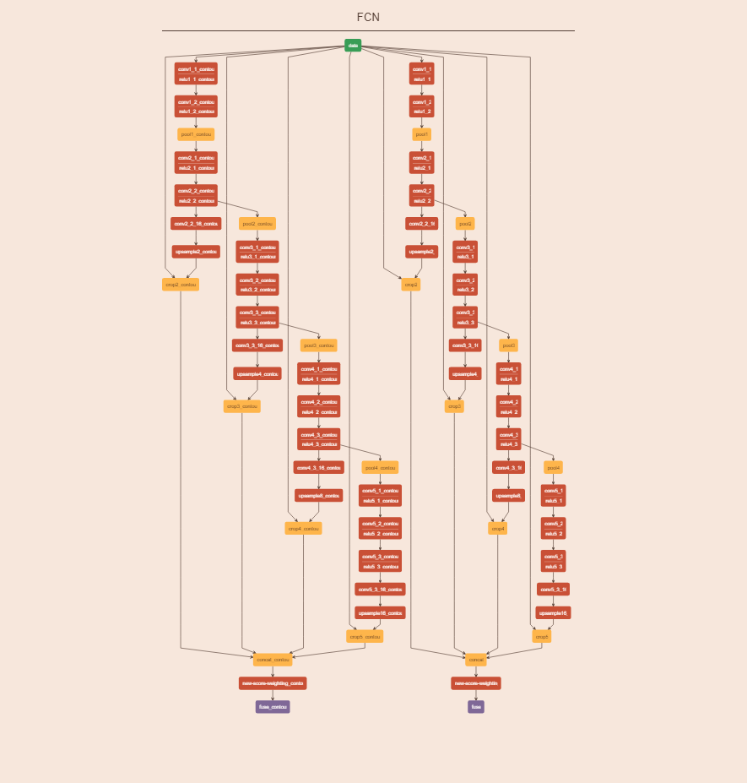
OSVOS Architecture
A fully-convolutional segmentation network with two branches:
Foreground segmentation branch
Contour Detection branch (To improve OSVOS performance - not used for the final results shown in the report)
Contour branch
Foreground branch
Both branches have exact same architecture but optimize two different losses.

Slide 3
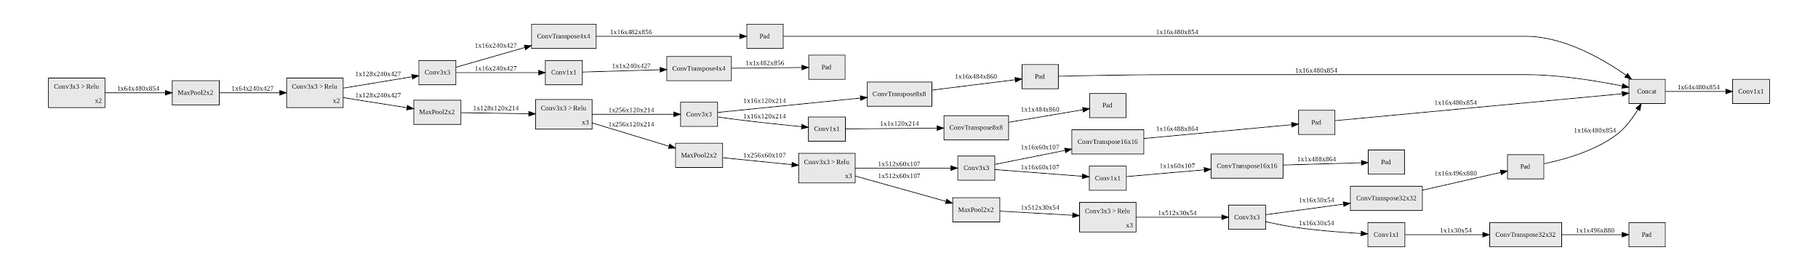
Network structure: Foreground branch
Main branch (VGG16 Backbone)
Feature map at Intermediate steps are upscaled and fused later
Fusing upscaled and padded (480x854) to make 64 channel output
The network neither uses the segmentation prediction from previous frames (Temporal information as used in a lot of recent papers) nor any extra flow information alongside segmentation masks. It solely works on the idea of k-shot learning. Even though all frames are processed independently, the results of paper are temporally coherent and stable.
Notes:
For a high resolution (un-annotated) version of this image: please refer this link
https://drive.google.com/file/d/1q8Y2Kph-ZPVIldPi_3bGqm66z9AKrSLV/view?usp=sharing

Slide 4
Contour Detection/ Boundary Snapping
Not used in our implementation but this is the second part of the paper.
To improve segmentation through OSVOS model (contour localization).
It’s an additional branch added to detect all contours in the scene unlike the foreground branch which detects only the foreground.
This branch is first pre-trained on the PASCAL-Context database which has Contour Annotations for objects.
After that, SuperPixels of the contours are computed using an Ultrametric Contour Map (UCM).
To get the final foreground segmentation, a foreground mask is selected first and the SuperPixels that overlap with the foreground mask over 50% are chosen via majority voting.
The Boundary Snapping adds 2.4 points of improvement to the score. (Please refer to ablation results of the paper in the slides)

Slide 5
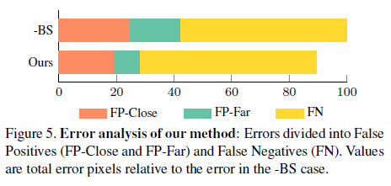
Error analysis with/without boundary snapping
False positives (FP):
FP-Close (20 px from the object)
FP-Far (more than 20 px away from the object)
Boundary Snapping reduces FP errors on the basis of alignment with the generic contours. So the major errors produced by the model are false negatives as reported in paper.

Slide 6
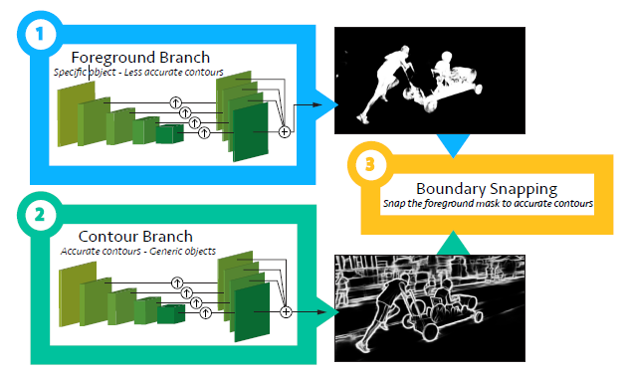
Two step training
First Step (Offline):
Parent Model: The VGG architecture pre-trained on ImageNet is trained on the DAVIS dataset. (Foreground branch: The fully connected layers for classification are removed and replaced with conv layers for segmentation.)
A parallel branch (contour) with same architecture is trained on PASCAL Context dataset.
The pre-trained parent model was available directly for our second step (Online training).

Slide 7
Two step training
Second step:
The first image of the WAD video sequence is trained using the network (One-Shot) and then tested on the rest of the sequence to segment foreground objects from the frames.
Results produced by our experiment are depicted as follows.

Slide 8

Ablation Study (Metrics Used)
Region Similarity (J): To measure the region-based segmentation similarity, that is, the number of mislabeled pixels. Jaccard Index was used which is the Intersection Over Union of the predicted segmentation and ground truth mask.
M-Predicted segmentation G-ground truth
Contour accuracy: (F) An F-score is calculated here with contour-based precision and recall Pc and Rc between the contour points of c(M) and c(G) (set of closed contours).
Temporal Stability: (T) A metric to measure stability ie to differentiate acceptable motion of the objects from the undesired instability. It estimates the deformation needed to transform the mask at one frame to the next one. A smooth and precise transformation would consider a stable output.

Slide 9
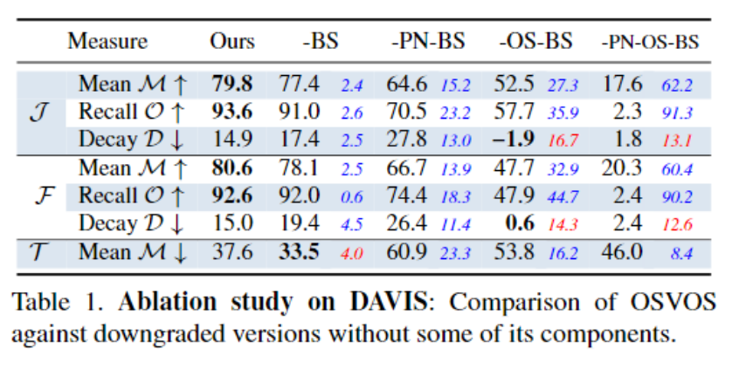
Ablation Study: OSVOS
Ablation studies were performed (in the paper) on this model to determine how the 3 features of the model affect performance.
Contribution in J score:
Pretraining of parent network = 15.2 points
One shot fine-tuning (online) = 27.3 points
Boundary Snapping = 2.4 points
Raw CNN (without any pre-training, one shot,
boundary snapping) gives a J score of 17.6 only
Which suggests that One shot training is contributing
Significantly towards the final segmentation performance.
Notes:
Here we can see that the background foreground segmentation results are heavily influenced by one-shot fine-tuning. This is the key reason behind why the backbone pretrained on DAVIS is able to produce segmentation results on a completely different WAD dataset with minimal fine-tuning.

Slide 10
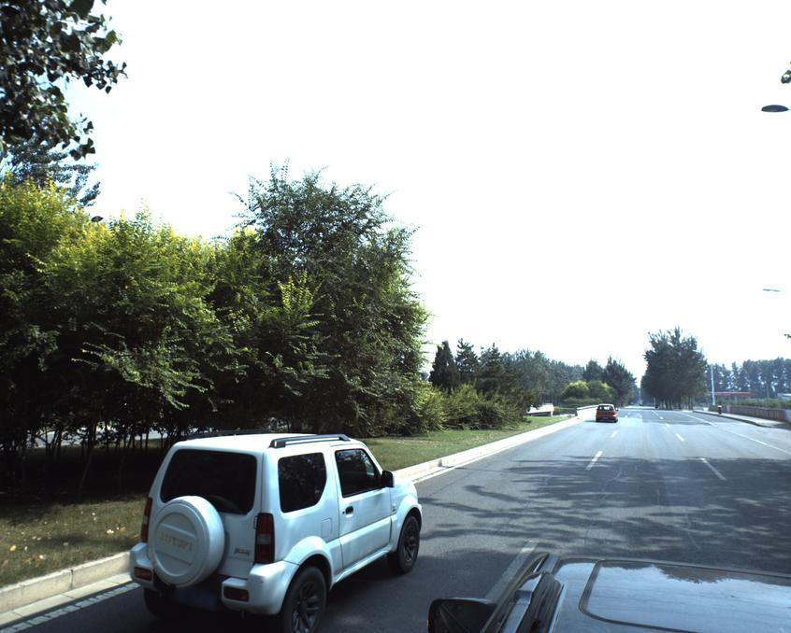
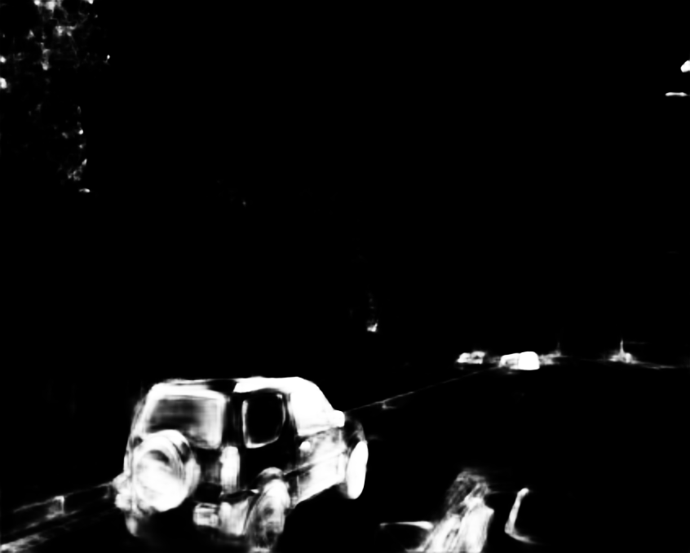
Experiment
Our aim is to segment all the movable objects belonging in the WAD dataset as the objective of the challenge is to distinguish stationary and movable objects for the driver. The objects include car, motorcycle, bicycle, pedestrian, truck, bus, and tricycle. (All coupled as vehicle class for this experiment)
WAD dataset for training: 170908_Camera_5 and 170908_Camera_6 and tested on a held out subset of video sequence 170908_Camera_5.
Adam optimizer with weight decay of 1e-5, learning rate of 1e-5 and weighted Cross-entropy loss for foreground branch
Trained for 1600 epochs.
Notes:
WAD dataset can be found on Kaggle: https://www.kaggle.com/c/cvpr-2018-autonomous-driving

